Slide 1
How to Obtain a Home Health Aide with
VA Health Benefits
Honored To Help Our Heroes!

Slide 2
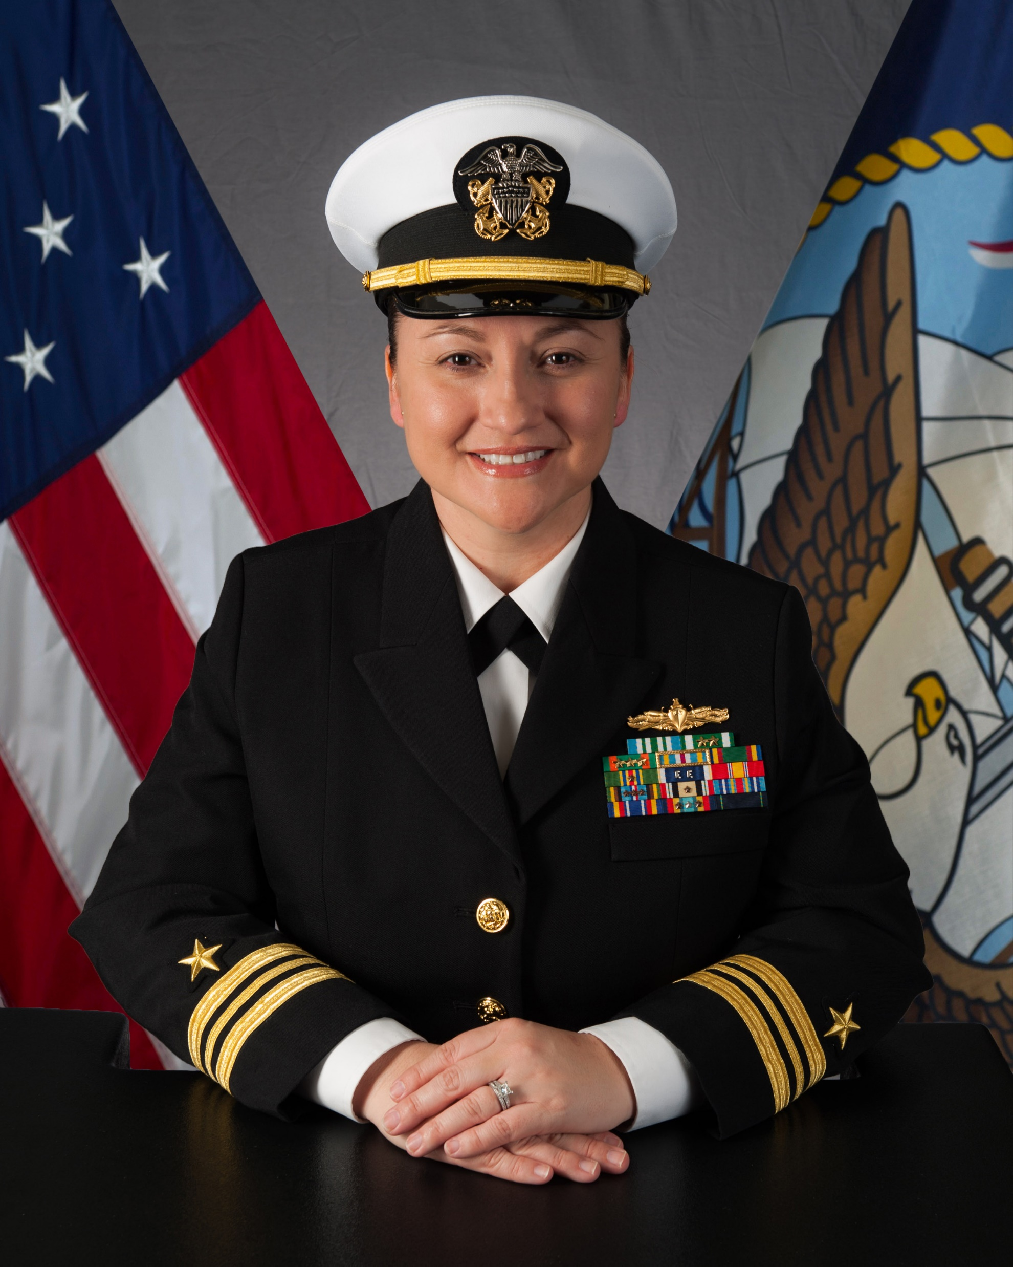
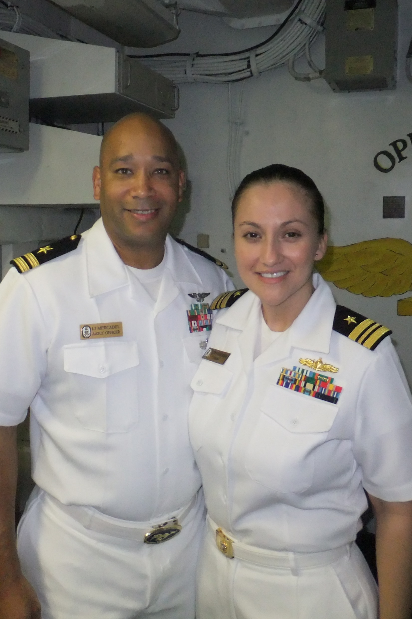
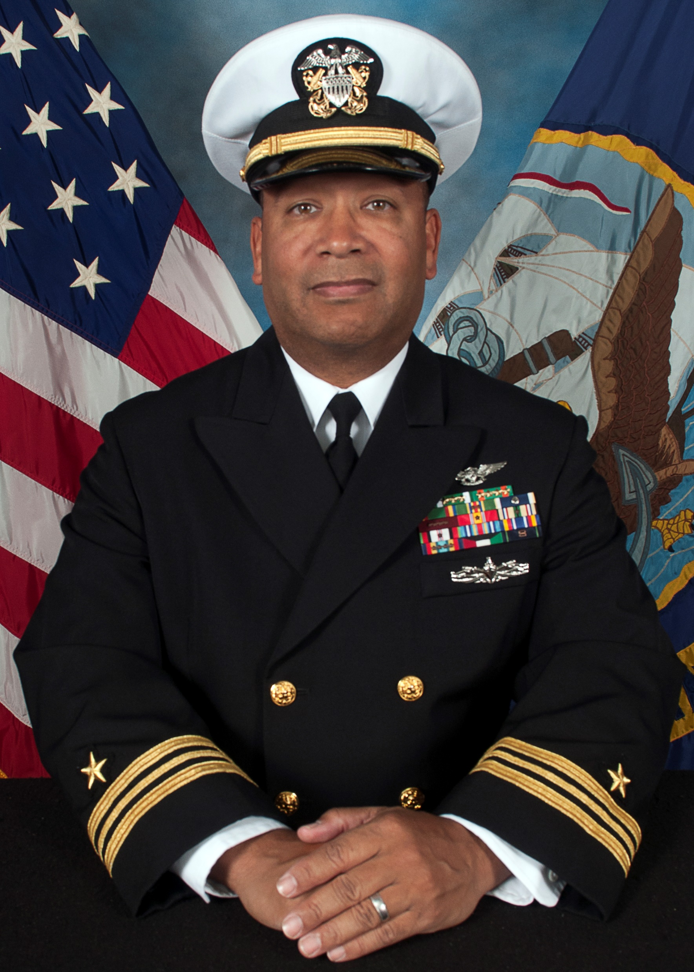
Who We Are
LCDR Yvonne Mercadel, USN (ret)
LCDR Mike Mercadel, USN (ret)

Slide 3
A Little About Us
Years of Service: Mike – 30 (1988-2018) / Yvonne – 20 (2001-2021)
Mike’s Background: Enlisted as Air Traffic Controller. Advanced from E-2 to E-7 in first 16 years,
then was selected for the Limited Duty Officer program as an Air Traffic Control Officer and
advanced from O-1E to O-4 in the next 14 years. Served on 3 aircraft carriers, 1 amphibius ship,
and multiple Navy airfields.
Yvonne’s Background: Grew up in Socorro, graduated from UTEP, received her commission
through Officer Candidate School in 2001 as a Surface Warfare Officer and advanced from
O-1 to O-4. Served on 4 amphibious ships, 1 guided missile destroyer, 8 sea deployments and
1 tour in Baghdad, Iraq.

Slide 4
Homemaker/Home Health Aide Care
What is Homemaker/Home Health Aide Care?
A Homemaker/Home Health Aide is a trained caregiver who can come to a Veteran's home and help them take care of themselves and their daily activities. Homemaker/Home Health Aides are not nurses, but they are supervised by a registered nurse who will help assess the Veteran's daily living needs.
Homemaker/Home Health Aides work for an agency that has a Community Care Network contract with VA. The services of a Homemaker or Home Health Aide can help Veterans remain living in their own home and can serve Veterans of any age. The VA’s goal is to keep the Veteran in their home as long as possible.

Slide 5
Homemaker/Home Health Aide Care
Am I eligible for Homemaker/Home Health Aide Care?
Since Homemaker/Home Health Aide (H/HHA) services are part of a service within the VA Health Standard Medical Benefits Package. All enrolled Veterans are eligible if they meet the clinical need for the service, regardless of their disability rating.
What is the process?
Receiving services under this program simply needs your primary care physician to write a referral for the service.
Once the referral is written, it goes to a H/HHA Coordinator who will decide the number of hours per week you are allotted. Anywhere from 11 to 58 hours per week.
The coordinator will call you to ask what your preference is for a provider. The agency must be part of the VA network of approved providers.
If you were to say Senior Helping Seniors, we would show up to setup a care plan and assign you a caregiver.

Slide 6
Homemaker/Home Health Aide Care
What services are provided by the Home Health Aide?
Dementia / Alzheimer’s Care
Companionship / Socialization
Personal Grooming / Dressing
Toileting / Showering Assistance
Mobility / Stability Assistance
Light Meal Preparation
Transportation to Appointments *
Handyman Repairs*

Slide 7
How can Veterans apply for VA health care?
Apply online at VA.gov/health-care/apply/application/introduction.
Call our toll-free hotline at 877-222-8387, M-F, 8:00 a.m. - 8:00 p.m. ET
Mail a completed, signed Application for Health Benefits (VA Form 10-10EZ) to: Health Eligibility Center - 2957 Clairmont Road, Suite 200, Atlanta, GA 30329
Walk in a signed Application for Health Benefits (VA Form 10-10EZ) to: El Paso VA Medical Center, 5001 N Piedras St, El Paso, TX 79930

Slide 8
Contact Us!
Seniors Helping Seniors
915-200-1199
info@shseastelpaso.com
www.SHSBorderland.com
Serving the Entire Borderland

